Slide 1

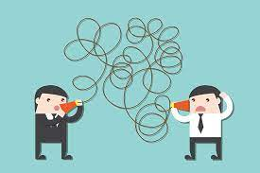


Problem-Communication and Teamwork during WFH
TEA
-3 common fears of budding game developer
Targeting right audience, Getting noticed by the right people, no proper and complete ideas.
How to solve them?- with a proper team to split the work and gather data from the masses.
With WFH, live discussions are difficult or maybe impossible.
IM
/ti:eIm/
Lack of effective communication
Effective communication
A new AIM for your TEAM

Slide 2
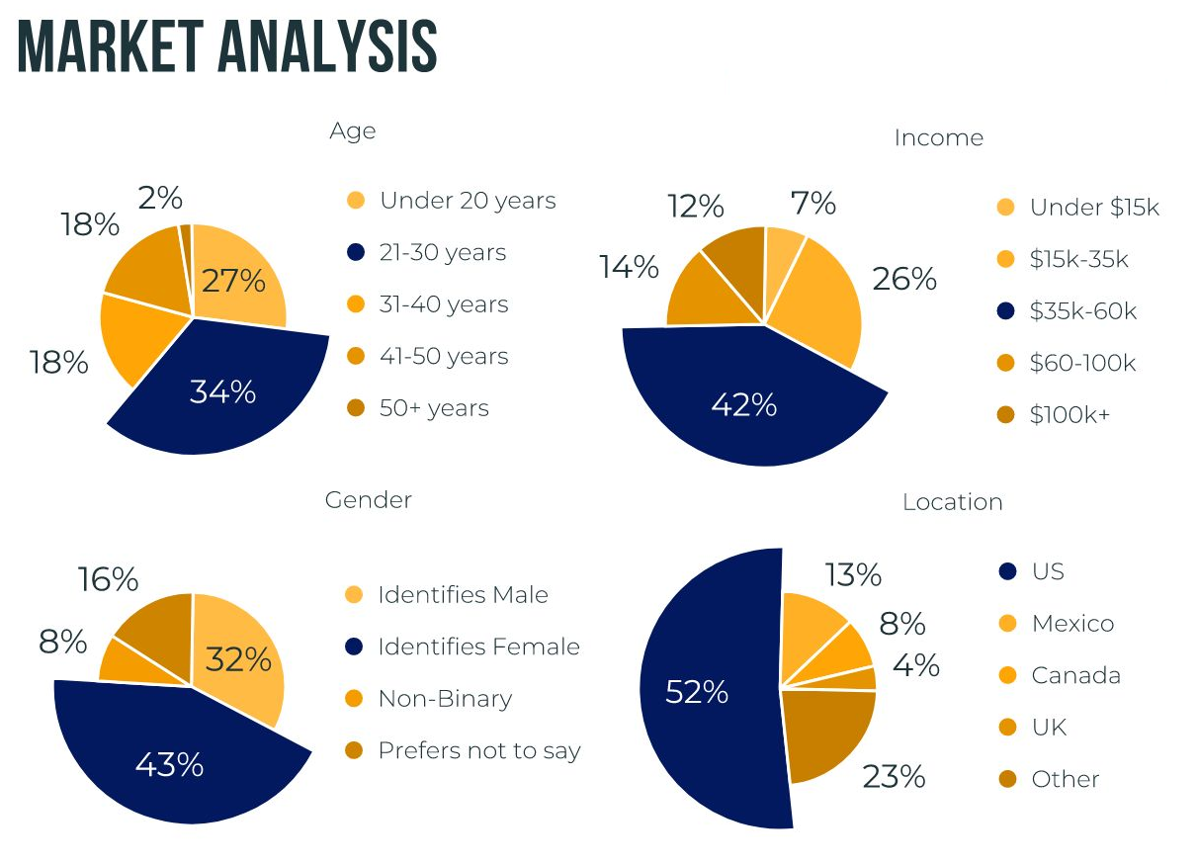
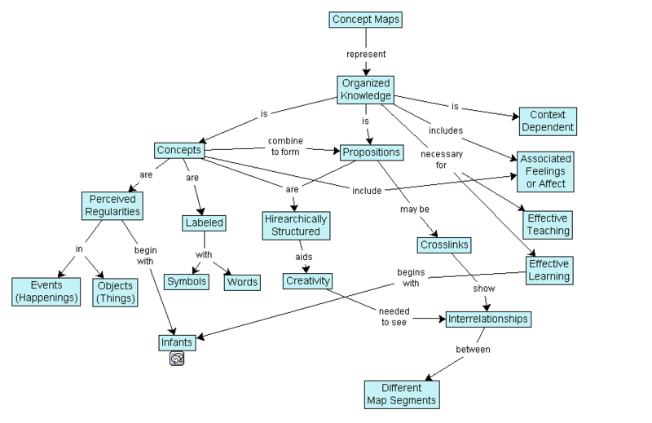
What is TE-AIM
An AI that can-
Help you communicate
Gather data
Analyse data
Improve morale
Increase work efficiency
By downloading our app, you can access it easily, then start chatting on the app like any other messenger app. The Ai within it will parse through and identify useful keywords.
Then it gets the context and gives back needed data!

Slide 3


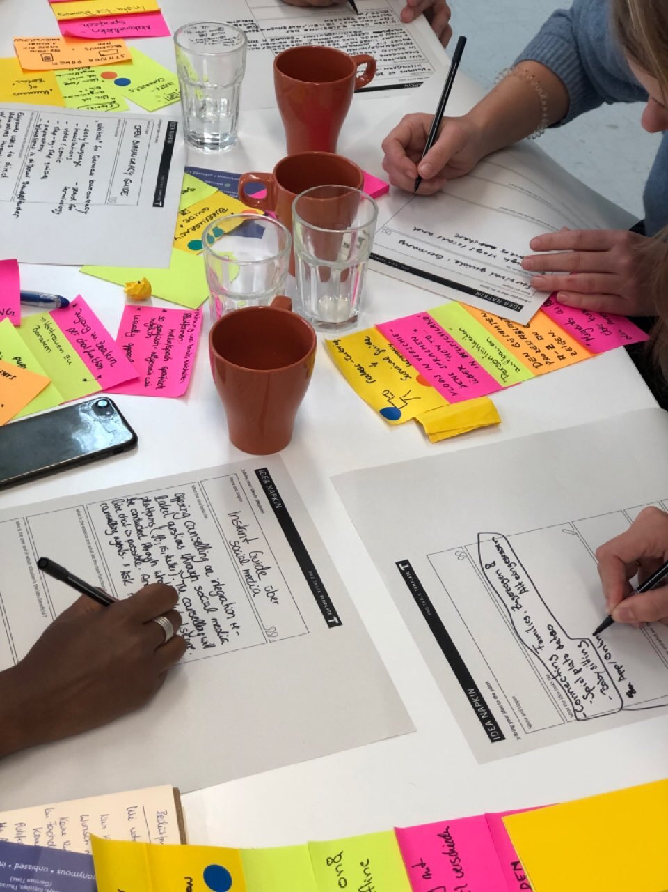
Benefits & Features
Why you should use this:
Saves time
Brings teammates in isolation, closer
Costs much cheaper than cross-platform video conferencing memberships and AI software renting-FREE
Reduces individual workloads and does it in less time
Targets the right audience and reaches out to get noticed
Easy patent registration
ChatBot function
Live video calls+recording
Big Data analysis
Comparison between ideas
More customers results in better data for others

Slide 4
Script-Addressing problems
The 3 most frequent concerns about being a budding game developer is targeting the right audience, having trouble getting noticed and creeping ideas. 2 of these can be solved with a proper team that helps with splitting work. However, with Work-From-Home, we cannot discuss with team members or work with others in real time. Even when your team is working on the same thing, being at home makes you feel alone. Being alone to shoulder a project seems daunting and reduces morale. Not really a quote, but I once heard a person say that working from home isn't that different from working in office cubicles. Separated by paper, yet miles apart. All we can hope for, is something to bring all of us closer together, to work to a common goal.
On the other hand, having creeping ideas, ideas that come and go, that cannot be visualized clearly or not being able to plot trends for the right age group can all be done with the right data and time. However, the lack of teamwork makes it hard to consolidate large amounts of data by individually, or come up with compelling evidence that you are going in the right way.

Slide 5
Script-What is it?
There have been many online forums, chat groups and social medias out there that facilitate group discussion and ideation, just adding anymore to it will seem like a redundant software. Thus, introducing TE-AIM. An app that helps your team in these trying times. Many have seen AI in the development and optimization of code. But it can also act as another brain, given enough instructions, it's just another member that is tasked with data collection and analysis. No, it does not completely replace human team members, it just helps you to visuals input from a third party as well as create useful audience demographics. So at least you can rest assured that you are on the right path.
We hope to benefit a lot of people, from companies, startups, even student groups. Anyone who wishes to understand audience demographics and idea management. As long as you are trying to interact with large number of people and appeal to them, TE-AIM is for you.

Slide 6
Script-How does it work
Its main components include team discussion, data analysis, a chat bot and idea generation.
It helps by acting as an additional member as well as a platform for discussion: videos, pictures and text can be sent, allowing TE-AIM to gather information and context, facilitating live calls and meetings. Calling upon it with the chatbot function, one can task it with retrieval of past forums and surveys carried out. Using machine learning on age groups, gender, genre enthusiasts and more, TE-AIM can generate useful inputs and interest groups that will like such an idea, highlighting the most effective and positive audience reactions. Lastly, after giving it enough data and a budding idea, it can expound on it, without the features and code of course. This ensures that you will have an interesting and feasible plan, that is 100% original. Or in this case, a story line with little to no plot holes.
And after your product or service is completed, easy patents applications and trademarks can be added for the needed security. Soon after, you may want to monetize your creation, and our app can also give suggestions as to how much you should sell it and where, all down to the material costs, targeted sales and customer needs and reviews.

Slide 7
Script-Benefits and Features
Many developers are afraid of spending money before they earn, and after that, they are not willing to spend their small profits. Well, don't worry! This software completely free, except for ads that keeps the software running, and collecting customer review data, which helps the AI get more accurate and promotes our service. At times, you may even get data before you even knew you needed it. I know that sometimes, people have internet issues or devices that don't work when you really need them to. Cross platforms don't really matter as it can run as long as you connect to the server, which houses all of our data and software. The data collected will only be used to apply machine learning, and help reach out to others. Rest assured that no personal data is recorded. We pride ourselves to assist you in your endeavours. We hope that you will enjoy such a service and promote it during the next meeting. Thank you.

Slide 8
Link for references and resources-
https://www.straitstimes.com/tech/making-a-video-game-with-global-partners-amid-pandemic-0
https://www.straitstimes.com/tech/tech-news/1-in-2-companies-in-singapore-has-sped-up-ai-roll-out-in-the-wake-of-covid-19-study
https://www.google.com/url?sa=i&url=https%3A%2F%2Fwww.theverge.com%2F2021%2F4%2F25%2F22399787%2Fisolation-grief-pandemic-covid19-mental-health&psig=AOvVaw3WjAR4nLVoszfoKuT0izPw&ust=1622255983316000&source=images&cd=vfe&ved=0CAIQjRxqFwoTCPClodSs6_ACFQAAAAAdAAAAABAE
https://www.google.com/imgres?imgurl=https%3A%2F%2Fglobal-uploads.webflow.com%2F59e16042ec229e00016d3a66%2F5e62f6ee447d120c93b1bc39_pie%2520chart%2520sample%25201.jpeg&imgrefurl=https%3A%2F%2Fwww.beautiful.ai%2Ftemplates%2Fpie-chart&tbnid=cHNhEGBRY_UTxM&vet=12ahUKEwip78-EsuvwAhWmOLcAHcPeAOEQMygAegUIARC1AQ..i&docid=dxFBaq7uKo-zGM&w=1920&h=1080&q=pie%20chart%20ai%20use&ved=2ahUKEwip78-EsuvwAhWmOLcAHcPeAOEQMygAegUIARC1AQ

